Slide 1
Depth First Search (DFS) Algorithm

Slide 2
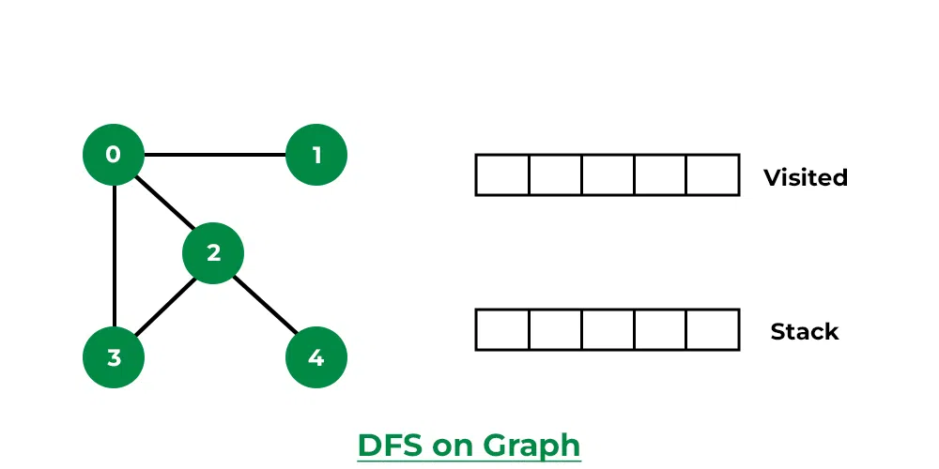
EX1
Solve the following graph using DFS algorithm
Stack and visited arrays are empty initially.

Slide 3
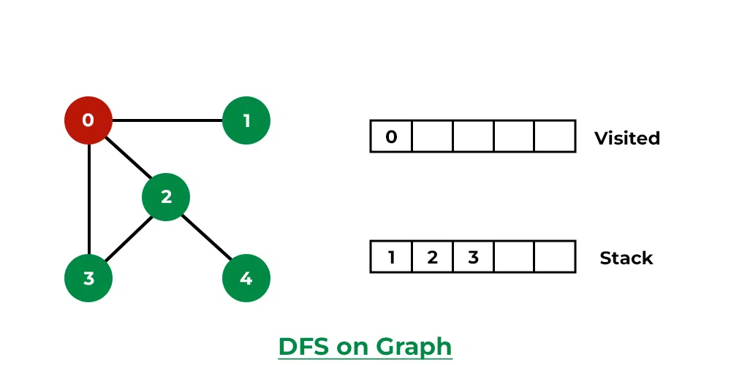
Step 2: Visit 0 and put its adjacent nodes which are not visited yet into the stack.

Slide 4
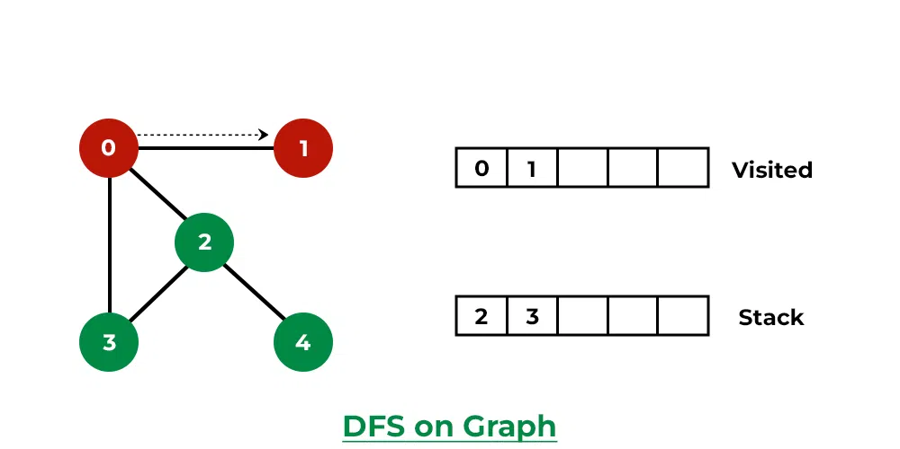
Step 3: Now, Node 1 at the top of the stack, so visit node 1 and pop it from the stack and put all of its adjacent nodes which are not visited in the stack.

Slide 5
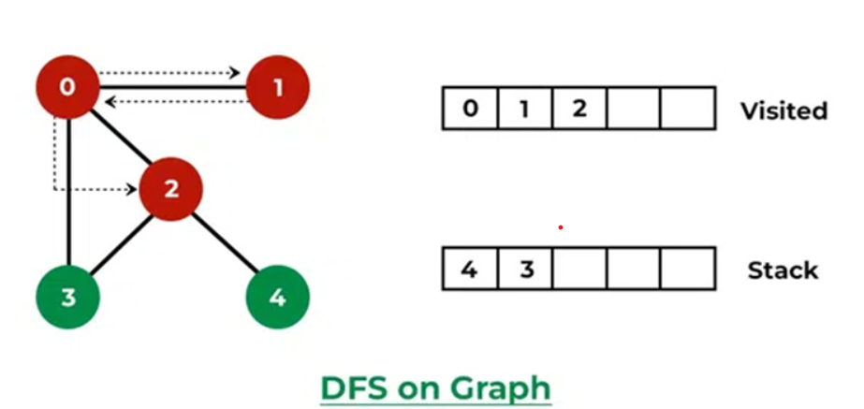
Step 5: Now, Node 2 at the top of the stack, so visit node 2 and pop it from the stack and put all of its adjacent nodes which are not visited in the stack.

Slide 6
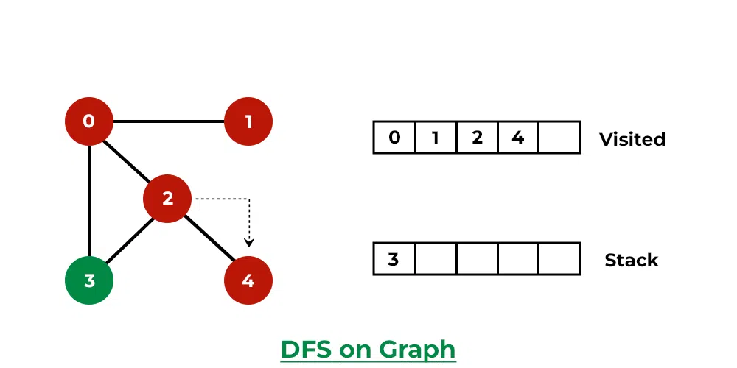
Step 5: Now, Node 4 at the top of the stack, so visit node 4 and pop it from the stack and put all of its adjacent nodes which are not visited in the stack.

Slide 7
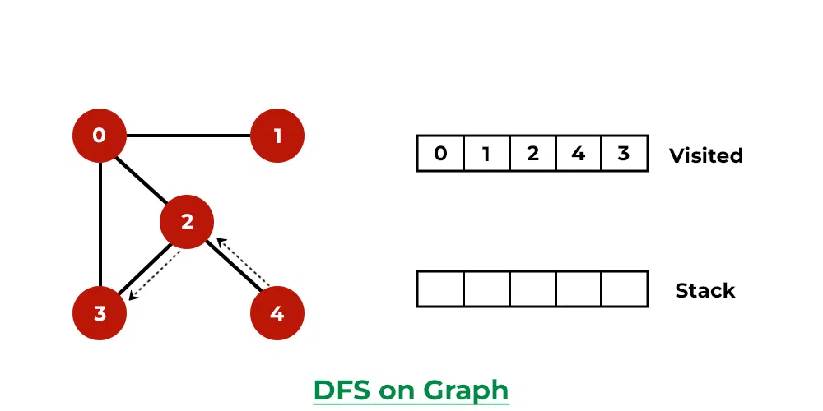
Step 6: Now, Node 3 at the top of the stack, so visit node 3 and pop it from the stack and put all of its adjacent nodes which are not visited in the stack.

Slide 8
Now, Stack becomes empty, which means we have visited all the nodes and our DFS traversal ends.

Slide 9
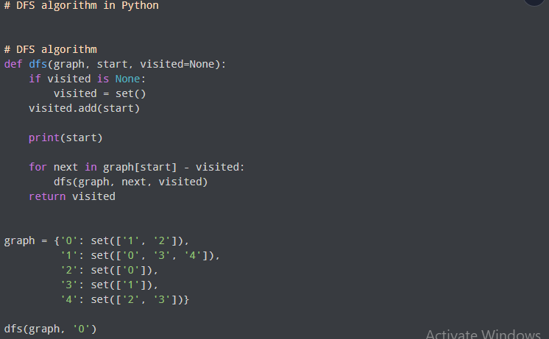
Python code

Slide 10
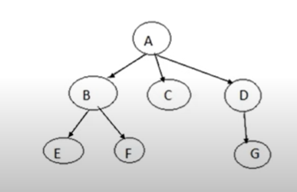
DFS Another Example(1)
Current | Stack
 | A
A | B,C,D
B | E,F,C, D
E | F,C,D
F | C,D
C | D
D | G
G
The traversal: A,B,E,F,C,D,G

Slide 11
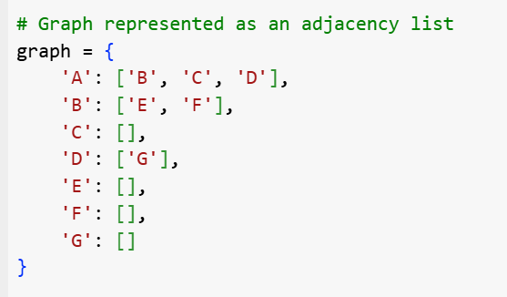
Code

Slide 12
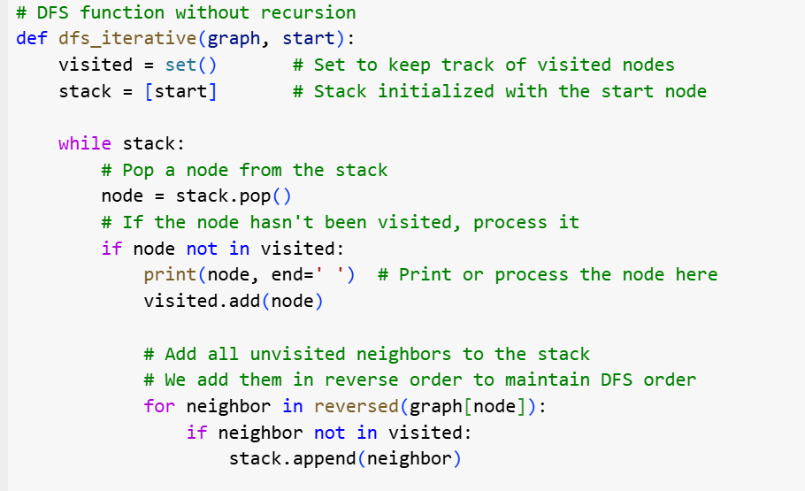
Code

Slide 13
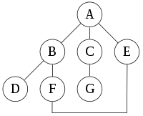
Ex2 Depth first Search
EX2:
For the following graph implement using DFS

Slide 14
Ex2: answer
Current | Stack
 | A
A | B,C,E
B | D,F,C,E
D | F,C,E
F | C,E
C | G,E
G | E
E
Traversal : A,B,D,F,C,G,E

Slide 15
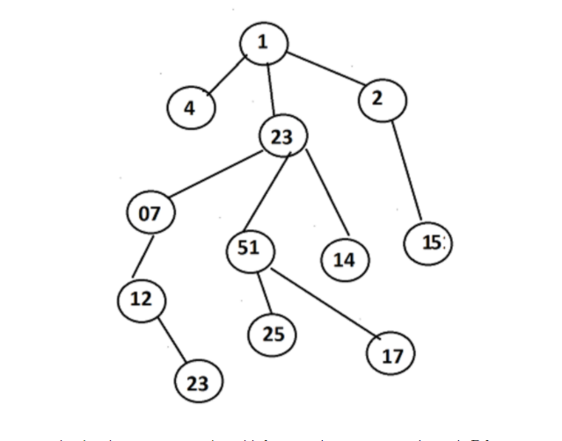
BFS Example

Slide 16
Answer
Current | Queue
 | 1
1 | 4,23,2
4 | 23,2
23 | 2,7,51,14
2 | 7,51,14,15
7 | 51,14,15,12
51 | 14,15,12,25,17
14 | 15,12,25,17
15 | 12,25,17
12 | 25,17
25 | 17
17
Answer: 1,4,23,2,7,51,14,15,12,25,17

Slide 17
10- Minutes quiz
Question:
A delivery service needs to move a package between various warehouses in a city. Each warehouse is connected by roads with varying toll costs. The goal is to find the cheapest route from the starting warehouse to the target destination.
Warehouses: W1, W2, W3, W4, W5
Roads (edges with toll costs): W1 - W2 (5), W1 - W3 (8), W2 - W4 (3), W3 - W4 (7), W4 - W5 (2)
Question: Find the path from W1 to W5 that incurs the lowest total toll cost.

Slide 18
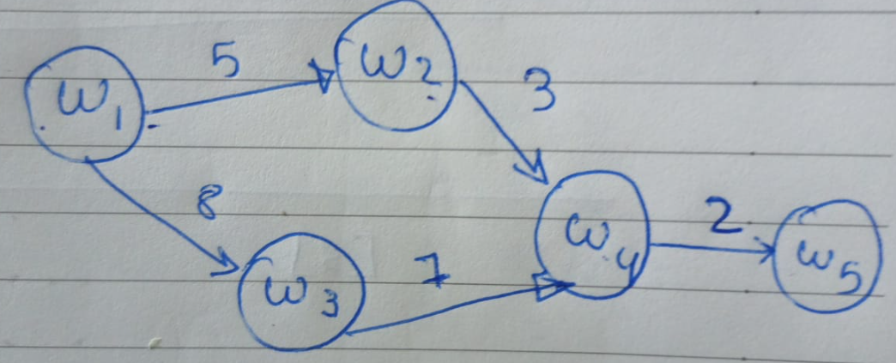
Answer
Current | priority queue
 | [w1] (0)
[W1] (0) | [W1,W3] , [W1,W3] (5) (8)
[W1, W2] (5) | [W1,W3], [W1, W2, W4] (8) (8)
[W1,W3] (8) | [W1,W2,W4], [W1,W3,W4] (8) (15)
[W1, W2, W4] | [W1,W3,W4], [W1,W2,W4,W5] (15) (10)
W1[,W2,W4,W5] | THE SOLUTION

Slide 19
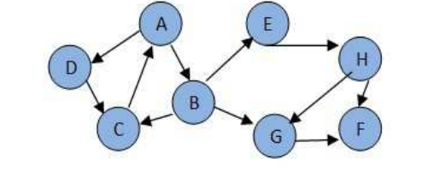
EX3:Consider the following graph. If there is ever a decision between multiple neighbor nodes in the DFS algorithms, assume we always choose the letter closest to the beginning of the alphabet first. In what order will the nodes be visited using a Depth First Search?

Slide 20
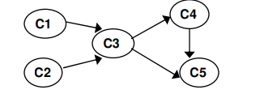
EX4: Apply DFS – based algorithm to solve the topological sorting problem for the given graph

